Slide 1
Cat Tanks!
Alex Linham, 18414029

Slide 2
Game overview, what is your x?
This game combines a cutesy art style with ballistics puzzles
You can customize your cat tanks, all 7 of them
Each cat tank has a unique playstyle and character story. They have personalised tastes for certain items too
You can personalise the aesthetics of each cat tanks bunker

Slide 3
Story and gameplay
The evil mice have catnapped your kittens. This means war!
Use your cat tanks to rain hell upon your opponents
After the puzzles, you can use your rescued kittens to build objects for your cat tanks, such as a new tank skin or a ball of yarn for their room

Slide 4
USP and key features
What makes this game unique is the interaction the player can have with the cat tanks
There are 7 unique cat tanks, with their own abilities
The player can express their own designs in the cats bunkers or on the battlefield
The player can also learn more about their cat tanks’ quirky personalities as they progress in game.

Slide 5
Target audience and devices
The target audience is Pegi 7 and above, as there will be mild cartoon violence. However, the game is deigned to be accessible for all age groups to enjoy.
Designed for iPhone 6 and above
Type | LED-backlit IPS LCD, capacitive touchscreen, 16M colors
Size | 4.7 inches, 60.9 cm² (~65.8% screen-to-body ratio)
Resolution | 750 x 1334 pixels, 16:9 ratio (~326 ppi density)
Multitouch | Yes
OS | iOS 8, upgradable to iOS 12.1
Chipset | Apple A8 (20 nm)
CPU | Dual-core 1.4 GHz Typhoon (ARM v8-based)
GPU | PowerVR GX6450 (quad-core graphics

Slide 6
Art direction and style
The game is very “cutesy” in style.
Keep colours vibrant and shapes as simple as possible. Bright colours will be visually striking and catch the eye, and the simple rounded shapes give the impression of a fun and comforting game

Slide 7
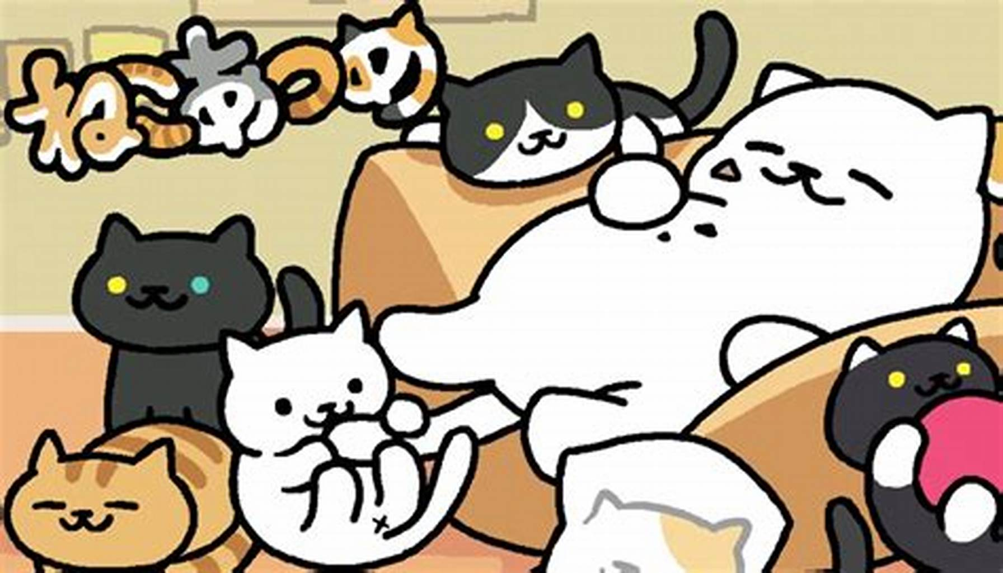
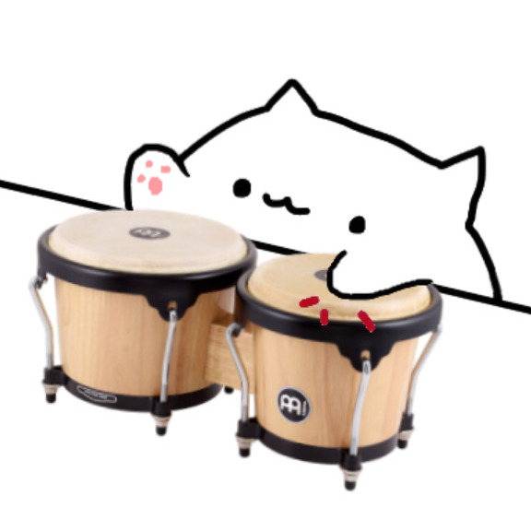
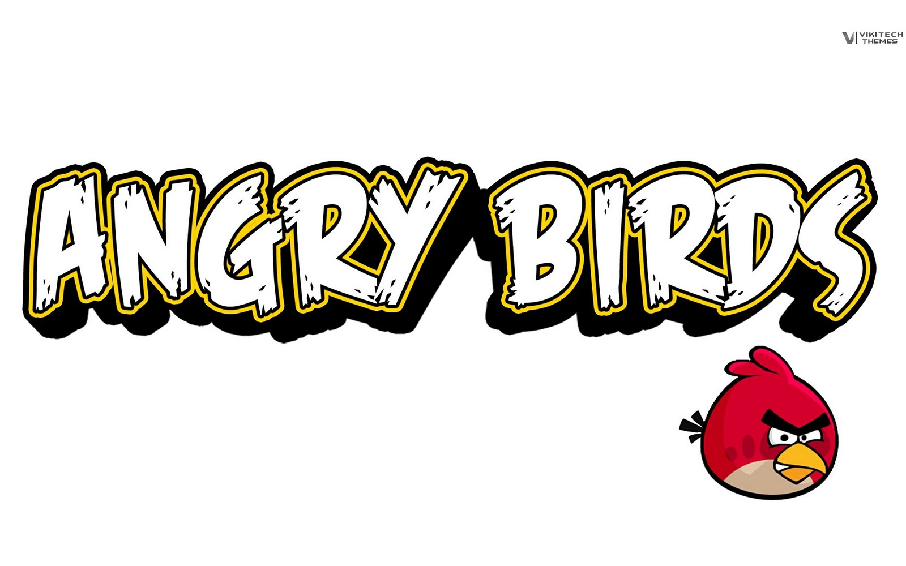
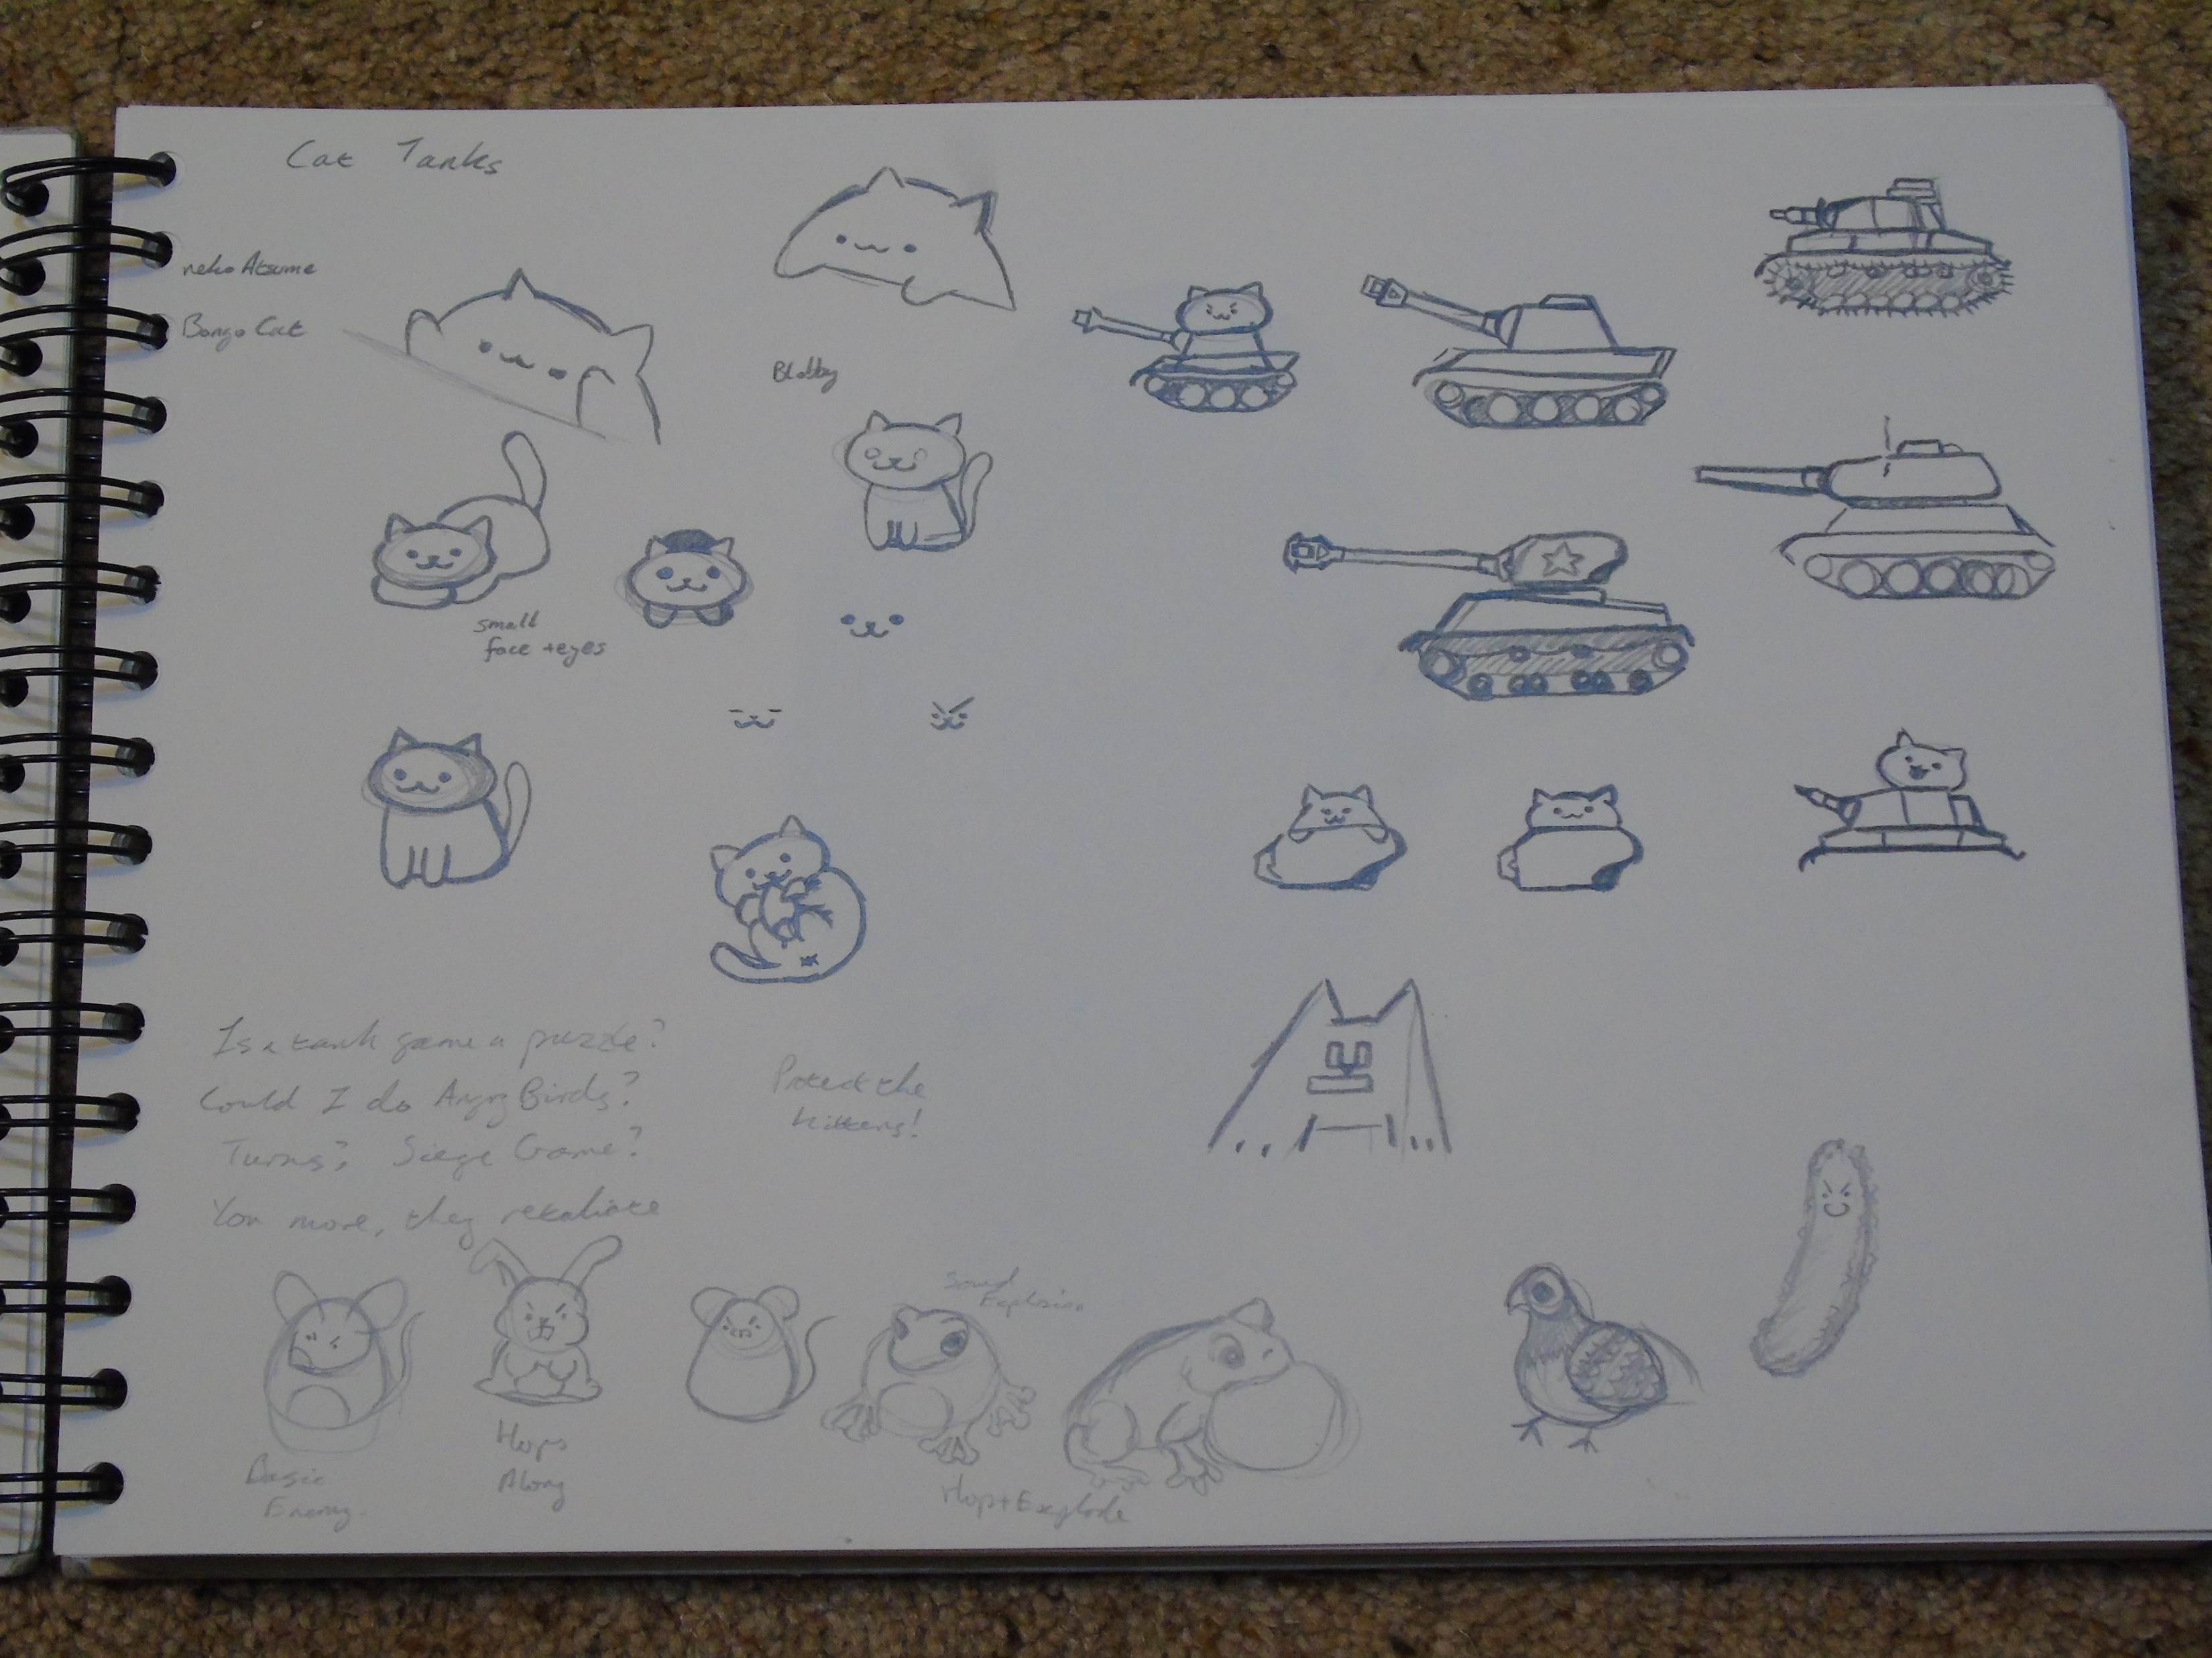
Competitors and inspirations
The game plays very similarly to Angry Birds, and the art style is reminiscent of Neko Atsume : Kitty Collector
Both of these games have been hugely popular, proving that there is a large consumer market for this type of product
Bongo cat was also an inspiration

